Slide 1

Scraping the Web, One Click at a Time
Ahmed Bin Faisal
13/10/2025

Slide 2




CONTENTS
01
Vision & Value
02
System Blueprint
03
Backend Router
04
Python Extraction Engine
05
Frontend Experience
06
Frontend Experience

Slide 3

01
Vision & Value

Slide 4

Instant Data from Any Career Page
Turn any LinkedIn or Indeed page into structured, copy-ready intelligence with a single click. No more manual copy-pasting.
Accuracy
Speed
Zero Formatting
Precise data extraction
Results in seconds
Copy-ready output

Slide 5
Dark Theme UI
Dynamic Icon
A modern, professional aesthetic that's easy on the eyes.
Glowing blue when active, gray when not. No guesswork.
Premium Feel, Zero Learning Curve
Advanced tech should feel effortless. Every design choice was made to create a delightful, intuitive experience.
Persistent State
One-Button Op
Accidentally close the popup? Your data is still there.
Simple and straightforward. Click once and let the tool work.

Slide 6
02
System Blueprint

Slide 7
Three-Layer Architecture
A loosely coupled system designed for independent evolution. Adding a new site doesn't require touching existing code.
1. Chrome Extension
2. Laravel API
3. Python Scrapers
Captures page & renders results.
Routes request to correct scraper.
Extracts structured JSON data.

Slide 8
The Journey of a Single Click
1
2
3
4
5
6
7
8
9
Capture
Request
Route
Delegate
Scrape
Respond
Capture
Persist
Display
A reliable, 10-step pipeline with idempotent steps and automatic cleanup.

Slide 9
03
Backend Router

Slide 10

Laravel as Traffic Controller
A thin PHP layer that acts as the central orchestrator, shielding the frontend from backend complexity.
Shields Complexity: The extension only talks to one endpoint, `/api/process-page`.
Dynamic Routing: Picks the right scraper at runtime based on the URL.
Secures Secrets: Keeps API keys and proxies out of the frontend code.

Slide 11
Choosing the Right Scraper
The `PageController` uses a simple, readable `if-else` chain to match URL patterns. This prioritizes clarity over cleverness, making it easy for anyone to add new rules.
// Match LinkedIn Profile
if (str_contains($url, 'linkedin.com/in/')) {
$scraperScript = 'person_scraper.py';
} elseif (str_contains($url, 'linkedin.com/jobs/')) {
$scraperScript = 'job_scraper.py';
} elseif (...) { // ... and so on
} else {
// Defensive default: return a polite error
return response()->json(['error' => 'Unsupported page type']);
}

Slide 12
04
Python Extraction Engine

Slide 13
Specialist Scripts, Shared Anatomy
Each scraper is a uniform, standalone CLI tool. New developers can clone, rename, and tweak, ensuring a consistent and predictable workflow.
CLI Tool
clean() Function
Accepts file path/URL, outputs JSON to stdout.
BeautifulSoup
Normalizes text and handles UTF-8 encoding safely.
Error Handling
Parses HTML with the lxml parser for speed.
Try-except blocks per field ensure resilience.

Slide 14

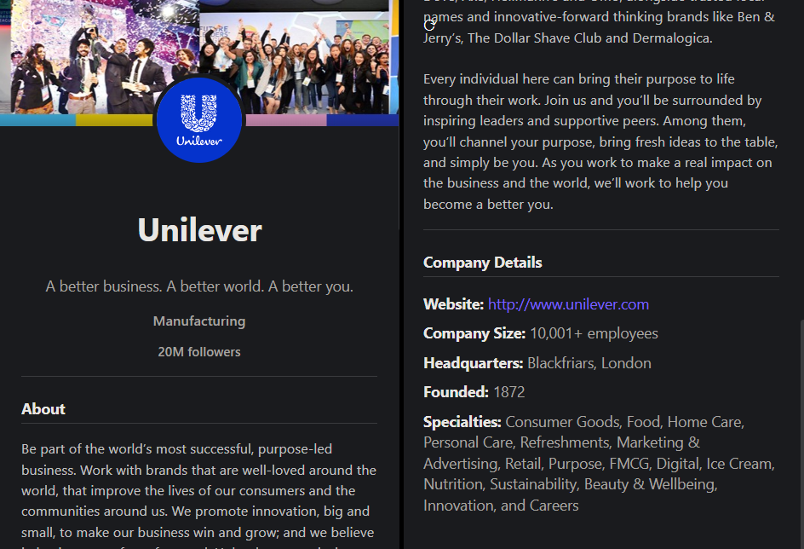
Resilient Selectors
A multi-layer strategy to build scrapers that survive website redesigns and CSS class shuffling.
1
Anchor on Stable IDs
Find a unique, stable ID or data-testid attribute.
2
Isolate the Section
Climb to the parent to confine the search.
3
Target Precisely
Use specific, class-agnostic selectors within the isolated block.

Slide 15
05
Frontend Experience

Slide 16
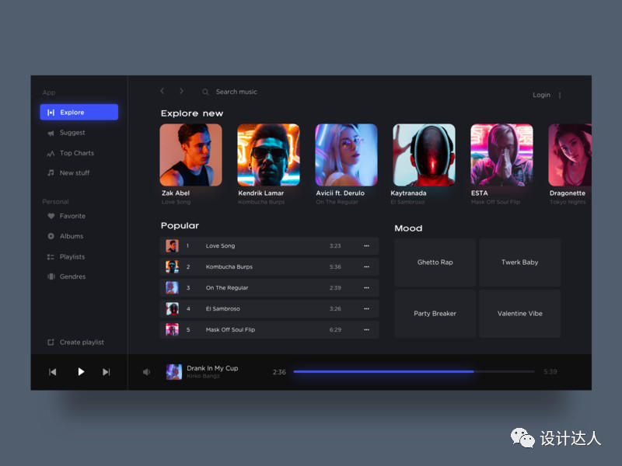
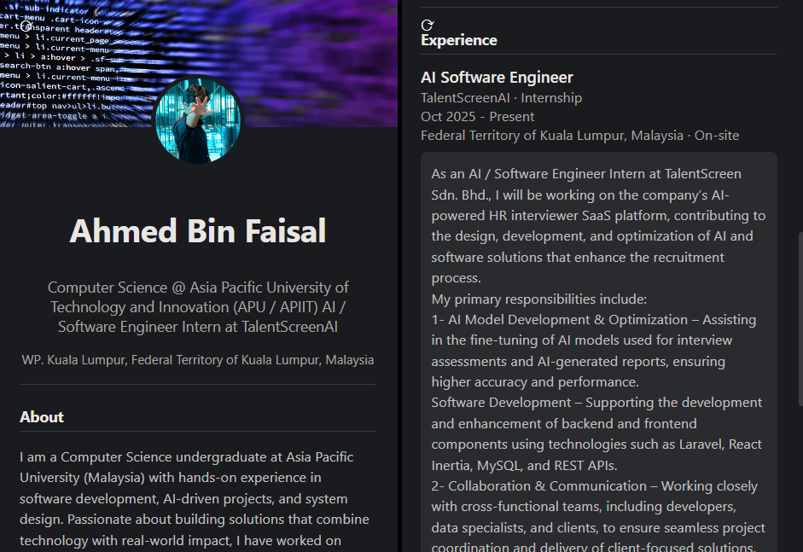
Popup That Remembers & Guides
Seamless user experience through intelligent state management and subtle visual cues.
Smart Persistence
Uses `chrome.storage.local` to remember results on a tab, even if the popup is closed.
Automatic Reset
Background script clears data on tab switch, ensuring a fresh start for each new task.
Dynamic Icon
A subtle coach: black means ready, gray means irrelevant.

Slide 17
Copy-Ready Formatting in One Tap
Data is instantly usable. Paste into your ATS, CRM, or email without any reformatting.
Hover-to-Reveal
Visual Feedback
Intelligent Copy
A copy icon fades in on hover for a clean UI.
Icon changes to a checkmark for 1.5 seconds on click.
Copies plain text, preserving line breaks for readability.

Slide 18
06
Hard-Won Lessons

Slide 19
Hard-Won Lessons: Technical Pitfalls
The UTF-8 Crash
clean(): encode('utf-8', 'replace')
Special characters like smart quotes caused JSON decoding to fail.
The Python Mismatch
Use venv/Scripts/python.exe
Global pip installs packages for a different Python than the one Laravel uses.
The Network Block
Send static HTML from browser
Office networks block server-side requests, causing scrapers to fail.

Slide 20

The Anti-Scraping Arms Race
Websites actively try to block scrapers with throttling, CAPTCHAs, and obfuscated data. We chose a pragmatic path.
The Tactical Decision
Instead of fighting network blocks with complex proxies, we re-architected the flow.
The Trade-off
Pro: Vastly higher success rate by leveraging the user's already-authenticated browser session.
Con: Requires a manual navigation step to the target page.

Slide 21
07
Extend & Scale

Slide 22
Five-Step Recipe for New Sites
The modular architecture makes extension easy. Follow this checklist to add a new site without touching existing code.
1
2
3
4
5
Permissions
Scraper
Router
UI Router
Display
Add URL to `manifest.json`.
Create new Python script.
Add rule to `PageController`.
Handle new type in `popup.js`.
Create new display function.

Slide 23
All the files can be accessed on GitHub
//github.com/dinnerboneA/Chrome-Scrapper-Extension-for-LinkedIn-and-Indeed-
Thank you for your Time.

